Slide 1
Course 1- Data Storytelling and Visualization.
Project Presentation
Sales Revenue Dashboard

Slide 2
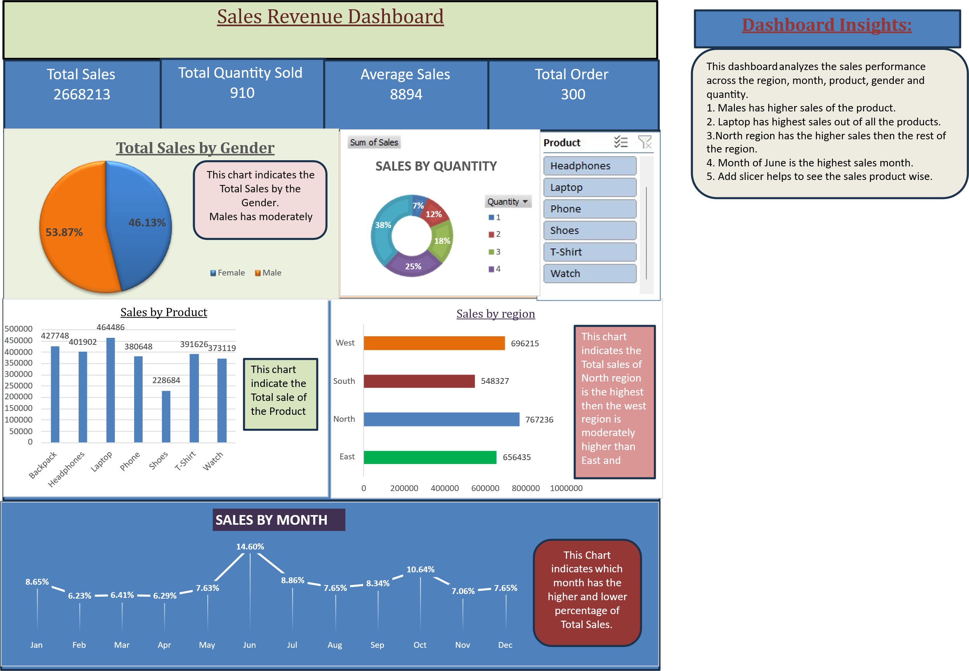

Slide 3
Gender Pivot table and Chart
Gender | Sum of Sales
Female | 46.13%
Male | 53.87%
Grand Total | 100.00%

Slide 4
Product Pivot table and Chart
Product | Sum of Sales
Backpack | 427748
Headphones | 401902
Laptop | 464486
Phone | 380648
Shoes | 228684
T-Shirt | 391626
Watch | 373119
Grand Total | 2668213

Slide 5
Month Wise Pivot table and Chart
Month | Sum of Sales
Jan | 8.65%
Feb | 6.23%
Mar | 6.41%
Apr | 6.29%
May | 7.63%
Jun | 14.60%
Jul | 8.86%
Aug | 7.65%
Sep | 8.34%
Oct | 10.64%
Nov | 7.06%
Dec | 7.65%
Grand Total | 100.00%

Slide 6
Region Wise Pivot table and Chart
Region | Sum of Sales
East | 656435
North | 767236
South | 548327
West | 696215
Grand Total | 2668213

Slide 7
Quantity Wise Pivot table and Chart
quantity | Sum of Sales
1 | 174674
2 | 321210
3 | 485850
4 | 665564
5 | 1020915
Grand Total | 2668213

Slide 8
Thank You.
By Prashant

